Slide 1
Mining Frequent Itemsets over Uncertain Databases
Yongxin Tong¹, Lei Chen¹, Yurong Cheng², Philip S. Yu³
¹The Hong Kong University of Science and Technology, Hong Kong, China
² Northeastern University, China
³University of Illinois at Chicago, USA

Slide 2
Outline
Motivations
  An Example of Mining Uncertain Frequent Itemsets (FIs)
  Deterministic FI Vs. Uncertain FI
  Evaluation Goals
Problem Definitions
Evaluations of Algorithms
  Expected Support-based Frequent Algorithms
  Exact Probabilistic Frequent Algorithms
  Approximate Probabilistic Frequent Algorithms
Conclusions

Slide 3
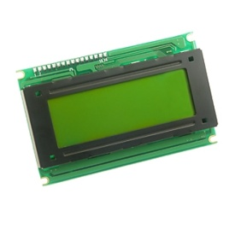

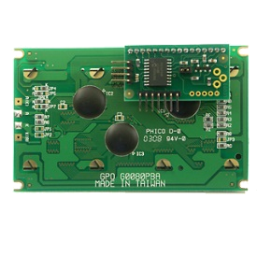
Motivation Example
In an intelligent traffic system, many sensors are deployed to collect real-time monitoring data in order to analyze the traffic jams.
TID | Location | Weather | Time | Speed | Probability
T1 | HKUST | Foggy | 8:30-9:00 AM | 90-100 | 0.3
T2 | HKUST | Rainy | 5:30-6:00 PM | 20-30 | 0.9
T3 | HKUST | Sunny | 3:30-4:00 PM | 40-50 | 0.5
T4 | HKUST | Rainy | 5:30-6:00 PM | 30-40 | 0.8

Slide 4
Motivation Example (cont’d)
TID | Location | Weather | Time | Speed | Probability
T1 | HKUST | Foggy | 8:30-9:00 AM | 90-100 | 0.3
T2 | HKUST | Rainy | 5:30-6:00 PM | 20-30 | 0.9
T3 | HKUST | Sunny | 3:30-4:00 PM | 40-50 | 0.5
T4 | HKUST | Rainy | 5:30-6:00 PM | 30-40 | 0.8
According to above data, we analyze the reasons that cause the traffic jams through the viewpoint of uncertain frequent pattern mining.
For example, we find that {Time = 5:30-6:00 PM; Weather = Rainy} is a frequent itemset with a high probability.
Therefore, under the condition of {Time = 5:30-6:00 PM; Weather = Rainy}, it is very likely to cause the traffic jams.

Slide 5
Outline
Motivations
  An Example of Mining Uncertain Frequent Itemsets (FIs)
  Deterministic FI Vs. Uncertain FI
  Evaluation Goals
Problem Definitions
Evaluations of Algorithms
  Expected Support-based Frequent Algorithms
  Exact Probabilistic Frequent Algorithms
  Approximate Probabilistic Frequent Algorithms
Conclusions

Slide 6
Deterministic Frequent Itemset Mining
Itemset: a set of items, such as {abc} in the right table.
Transaction: a tuple <tid, T> where tid is the identifier, and T is a itemset, such as the first line in the right table is a transaction.
TID | Transaction
T1 | a b c d e
T2 | a b c d
T3 | a b c f
T4 | a b c e
A Transaction Database
Support: Given an itemset X, the support of X is the number of transactions containing X. i.e. support({abc})=4.
Frequent Itemset: Given a transaction database TDB, an itemset X, a minimum support σ, X is a frequent itemset iff. sup(X) > σ
For example: Given σ=2, {abcd} is a frequent itemset.
The support of an itemset is only an simple count in the deterministic frequent itemset mining!

Slide 7
Deterministic FIM Vs. Uncertain FIM
Transaction: a tuple <tid, UT> where tid is the identifier, and UT={u₁(p₁), ……, u_{m}(p_{m})} which contains m units. Each unit has an item u_{i} and an appearing probability p_{i}.
TID | Transaction
T1 | a(0.8) b(0.2) c(0.9) d(0.5) e(0.9)
T2 | a(0.8) b(0.7) c(0.9) d(0.5) f(0.7)
T3 | a(0.5) c(0.9) f(0.1) g(0.4)
T4 | b(0.5) f(0.1)
An Uncertain Transaction Database
Support: Given an uncertain database UDB, an itemset X, the support of X, denoted sup(X), is a random variable.
How to define the concept of frequent itemset in uncertain databases?
There are currently two kinds of definitions:
  Expected Support-based frequent itemset.
  Probabilistic frequent itemset.

Slide 8
Outline
Motivations
  An Example of Mining Uncertain Frequent Itemsets (FIs)
  Deterministic FI Vs. Uncertain FI
  Evaluation Goals
Problem Definitions
Evaluations of Algorithms
  Expected Support-based Frequent Algorithms
  Exact Probabilistic Frequent Algorithms
  Approximate Probabilistic Frequent Algorithms
Conclusions

Slide 9
Evaluation Goals
  Explain the relationship of exiting two definitions of frequent itemsets over uncertain databases.
  The support of an itemset follows Possion Binomial distribution.
  When the size of data is large, the expected support can approximate the frequent probability with the high confidence.
  Clarify the contradictory conclusions in existing researches.
  Can the framework of FP-growth still work in uncertain environments?
  Provide an uniform baseline implementation and an objective experimental evaluation of algorithm performance.
  Analyze the effect of the Chernoff Bound in the uncertain frequent itemset mining issue.

Slide 10
Outline
Motivations
  An Example of Mining Uncertain Frequent Itemsets (FIs)
  Deterministic FI Vs. Uncertain FI
  Evaluation Goals
Problem Definitions
Evaluations of Algorithms
  Expected Support-based Frequent Algorithms
  Exact Probabilistic Frequent Algorithms
  Approximate Probabilistic Frequent Algorithms
Conclusion

Slide 11
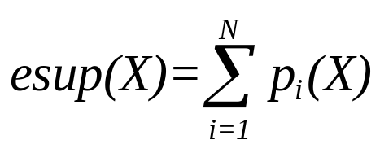

Expected Support-based Frequent Itemset
Expected Support
  Given an uncertain transaction database UDB including N transactions, and an itemset X, the expected support of X is:
Expected-Support-based Frequent Itemset
  Given an uncertain transaction database UDB including N transactions, a minimum expected support ratio min_esup, an itemset X is an expected support-based frequent itemset if and only if

Slide 12

Probabilistic Frequent Itemset
Frequent Probability
  Given an uncertain transaction database UDB including N transactions, a minimum support ratio min_sup, and an itemset X, X’s frequent probability, denoted as Pr(X), is:
Probabilistic Frequent Itemset
  Given an uncertain transaction database UDB including N transactions, a minimum support ratio min_sup, and a probabilistic frequent threshold pft, an itemset X is a probabilistic frequent itemset if and only if

Slide 13
Examples of Problem Definitions
TID | Transaction
T1 | a(0.8) b(0.2) c(0.9) d(0.5) e(0.9)
T2 | a(0.8) b(0.7) c(0.9) d(0.5) f(0.7)
T3 | a(0.5) c(0.8) f(0.1) g(0.4)
T4 | b(0.5) f(0.1)
sup(a) | 0 | 1 | 2 | 3
Probability | 0.02 | 0.18 | 0.48 | 0.32
An Uncertain Transaction Database
The Probability Distribution of sup(a)
Expected-Support-based Frequent Itemset
  Given the uncertain transaction database above, min_esup=0.5, there are two expected-support-based frequent itemsets: {a} and {c} since esup(a)=2.1 and esup(c)=2.6 > 2 = 4×0.5.
Probabilistic Frequent Itemset
  Given the uncertain transaction database above, min_sup=0.5, and pft=0.7, the frequent probability of {a} is: Pr(a)=Pr{sup(a) ≥4×0.5}= Pr{sup(a) =2}+Pr{sup(a) =3}=0.48+0.32=0.8>0.7.

Slide 14
Outline
Motivations
  An Example of Mining Uncertain Frequent Itemsets (FIs)
  Deterministic FI Vs. Uncertain FI
  Evaluation Goals
Problem Definitions
Evaluations of Algorithms
  Expected Support-based Frequent Algorithms
  Exact Probabilistic Frequent Algorithms
  Approximate Probabilistic Frequent Algorithms
Conclusions

Slide 15
8 Representative Algorithms
Type | Algorithms | Highlights
Expected Support–based Frequent Algorithms | UApiori | Apriori-based search strategy
 | UFP-growth | UFP-tree index structure ; Pattern growth search strategy
 | UH-Mine | UH-struct index structure ; Pattern growth search strategy
Exact Probabilistic Frequent Algorithms | DP | Dynamic programming-based exact algorithm
 | DC | Divide-and-conquer-based exact algorithm
Approximation Probabilistic Frequent Algorithms | PDUApiori | Poisson-distribution-based approximation algorithm
 | NDUApiori | Normal-distribution-based approximation algorithm
 | NDUH-Mine | Normal-distribution-based approximation algorithm UH-struct index structure

Slide 16
Experimental Evaluation
Characteristics of Datasets
Dataset | Number of Transactions | Number of Items | Average Length | Density
Connect | 67557 | 129 | 43 | 0.33
Accident | 30000 | 468 | 33.8 | 0.072
Kosarak | 990002 | 41270 | 8.1 | 0.00019
Gazelle | 59601 | 498 | 2.5 | 0.005
T20I10D30KP40 | 320000 | 994 | 25 | 0.025
Default Parameters of Datasets
Dataset | Mean | Var. | min_sup | pft
Connect | 0.95 | 0.05 | 0.5 | 0.9
Accident | 0.5 | 0.5 | 0.5 | 0.9
Kosarak | 0.5 | 0.5 | 0.0005 | 0.9
Gazelle | 0.95 | 0.05 | 0.025 | 0.9
T20I10D30KP40 | 0.9 | 0.1 | 0.1 | 0.9

Slide 17
Outline
Motivations
  An Example of Mining Uncertain Frequent Itemsets (FIs)
  Deterministic FI Vs. Uncertain FI
  Existing Problems and Evaluation Goals
Problem Definitions
Evaluations of Algorithms
  Expected Support-based Frequent Algorithms
  Exact Probabilistic Frequent Algorithms
  Approximate Probabilistic Frequent Algorithms
Conclusion

Slide 18
Expected Support-based Frequent Algorithms
UApriori (C. K. Chui et al., in PAKDD’07 & 08)
  Extend the classical Apriori algorithm in deterministic frequent itemset mining.
UFP-growth (C. Leung et al., in PAKDD’08 )
  Extend the classical FP-tree data structure and FP-growth algorithm in deterministic frequent itemset mining.
UH-Mine (C. C. Aggarwal et al., in KDD’09 )
  Extend the classical H-Struct data structure and H-Mine algorithm in deterministic frequent itemset mining.

Slide 19
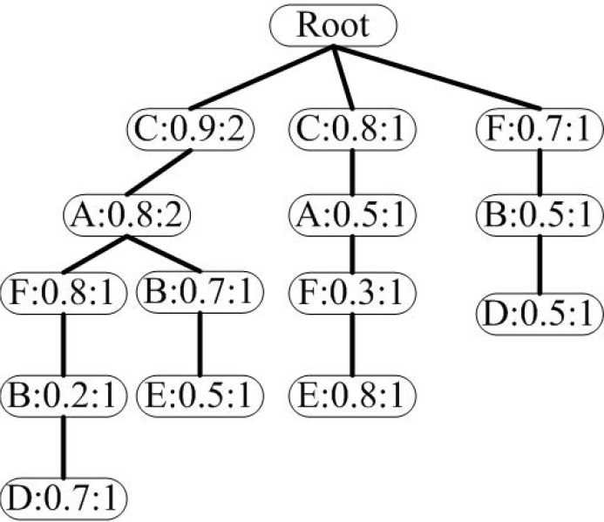
UFP-growth Algorithm
TID | Transaction
T1 | a(0.8) b(0.2) c(0.9) d(0.7) f(0.8)
T2 | a(0.8) b(0.7) c(0.9) e(0.5)
T3 | a(0.5) c(0.8) e(0.8) f(0.3)
T4 | b(0.5) d(0.5) f(0.7)
An Uncertain Transaction Database
UFP-Tree

Slide 20
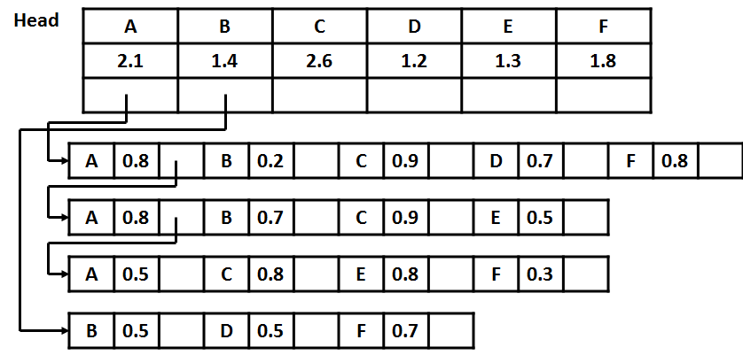
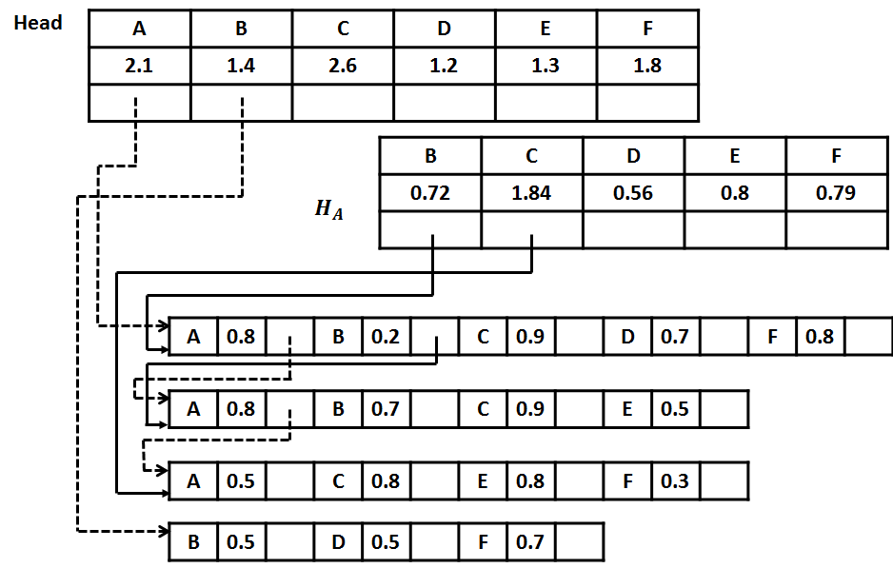
UH-Mine Algorithm
TID | Transaction
T1 | a(0.8) b(0.2) c(0.9) d(0.7) f(0.8)
T2 | a(0.8) b(0.7) c(0.9) e(0.5)
T3 | a(0.5) c(0.8) e(0.8) f(0.3)
T4 | b(0.5) d(0.5) f(0.7)
UDB: An Uncertain Transaction Database
UH-Struct Generated from UDB
UH-Struct of Head Table of A

Slide 21
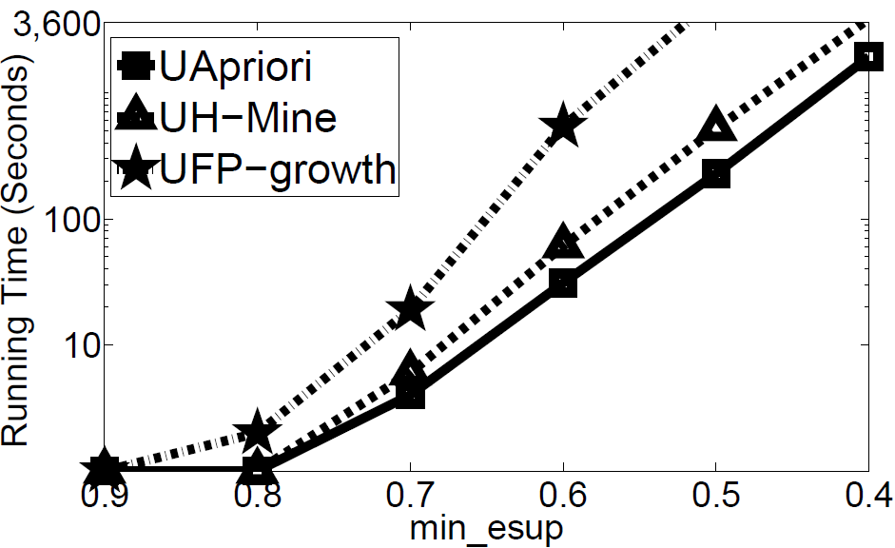
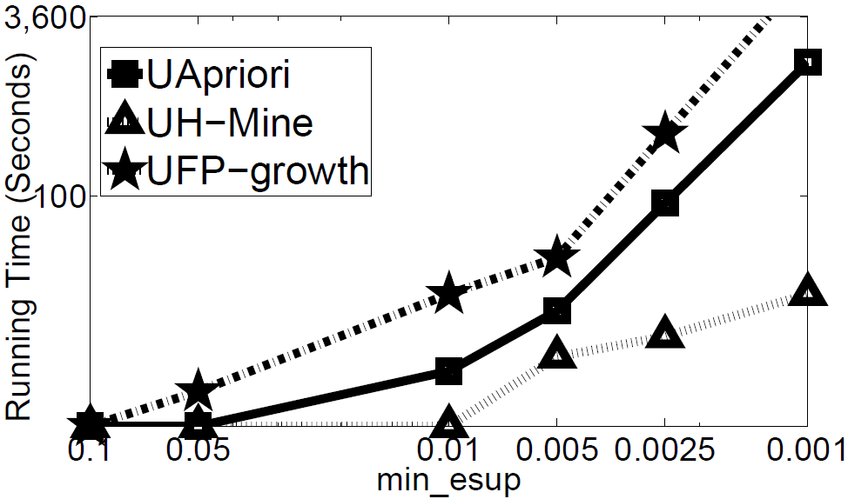
Running Time
(a) Connet (Dense) (b) Kosarak (Sparse)
Running Time w.r.t min_esup

Slide 22
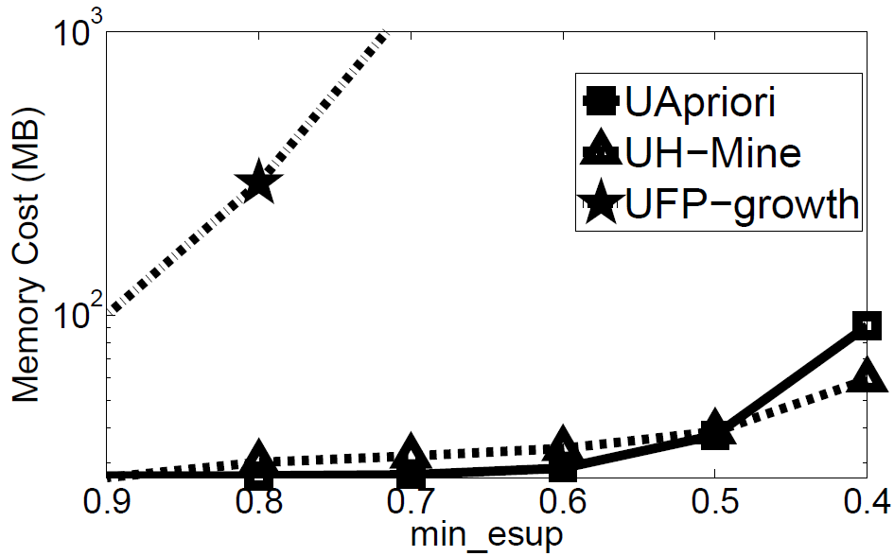
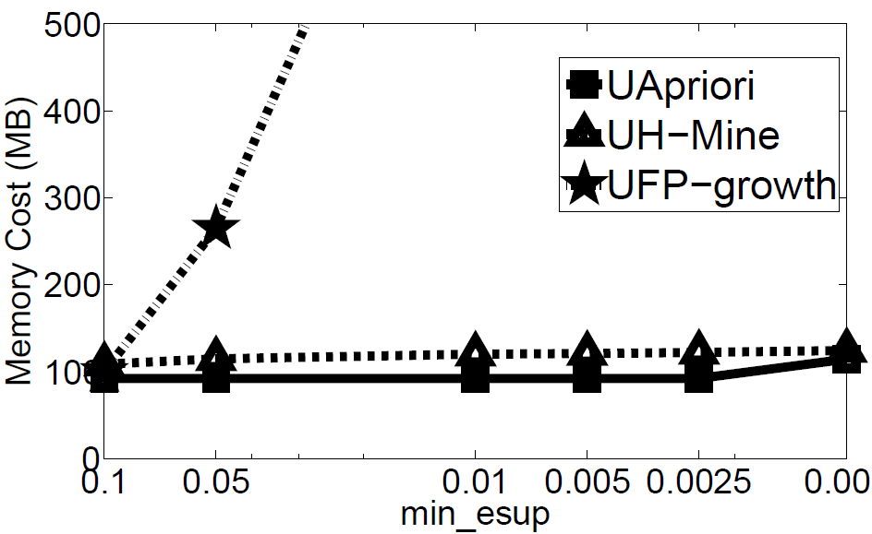
Memory Cost
(a) Connet (Dense) (b) Kosarak (Sparse)
Running Time w.r.t min_esup

Slide 23
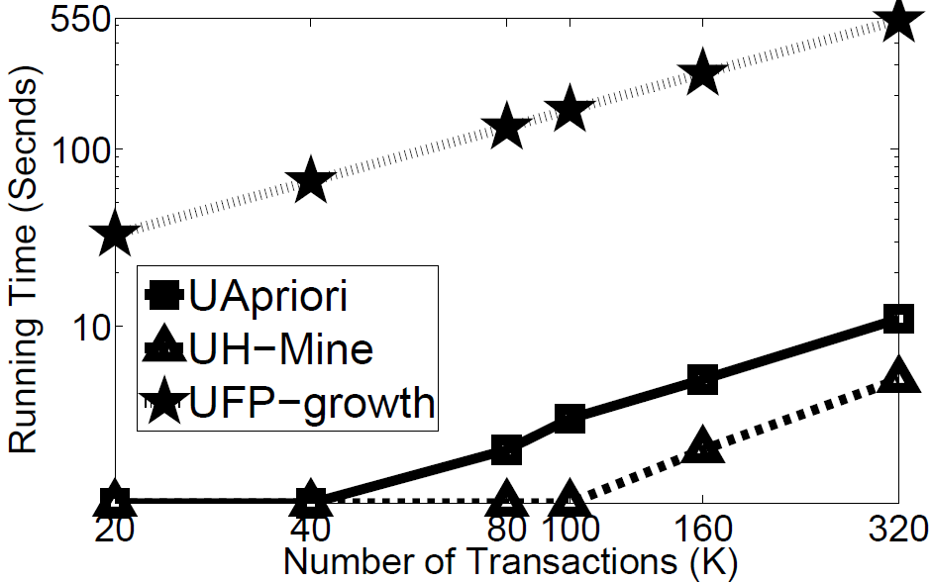
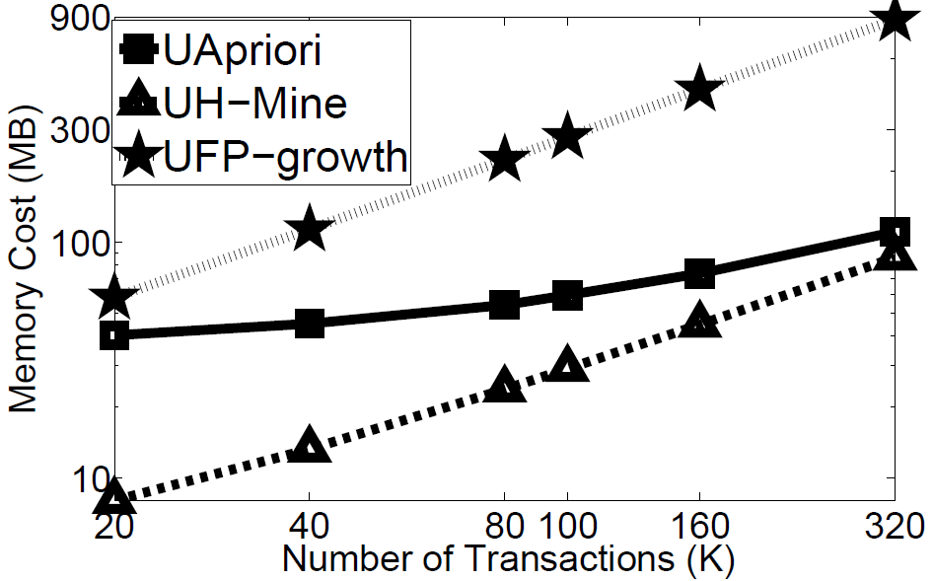
Scalability
(a) Scalability w.r.t Running Time (b) Scalability w.r.t Memory Cost

Slide 24
Review: UApiori Vs. UFP-growth Vs. UH-Mine
Dense Dataset: UApriori algorithm usually performs very good
Sparse Dataset: UH-Mine algorithm usually performs very good.
In most cases, UF-growth algorithm cannot outperform other algorithms

Slide 25
Outline
Motivations
  An Example of Mining Uncertain Frequent Itemsets (FIs)
  Deterministic FI Vs. Uncertain FI
  Evaluation Goals
Problem Definitions
Evaluations of Algorithms
  Expected Support-based Frequent Algorithms
  Exact Probabilistic Frequent Algorithms
  Approximate Probabilistic Frequent Algorithms
Conclusions

Slide 26
Exact Probabilistic Frequent Algorithms
DP Algorithm (T. Bernecker et al., in KDD’09)
  Use the following recursive relationship:
  Computational Complexity: O(N²)
DC Algorithm (L. Sun et al., in KDD’10)
  Employ the divide-and-conquer framework to compute the frequent probability
  Computational Complexity: O(Nlog²N)
Chernoff Bound-based Pruning
  Computational Complexity: O(N)

Slide 27
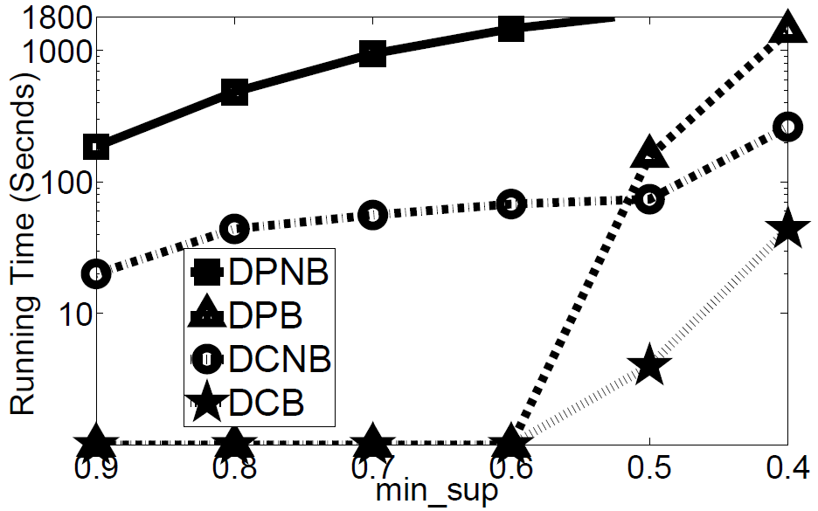
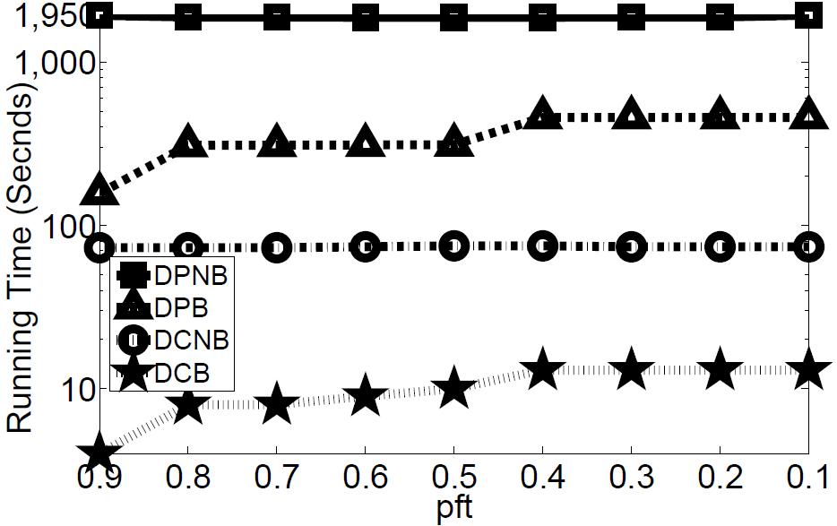
Running Time
(a) Accident (Time w.r.t min_sup) (b) Kosarak (Time w.r.t pft)

Slide 28
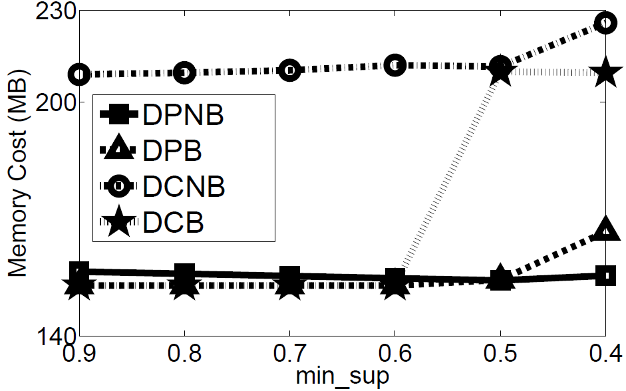
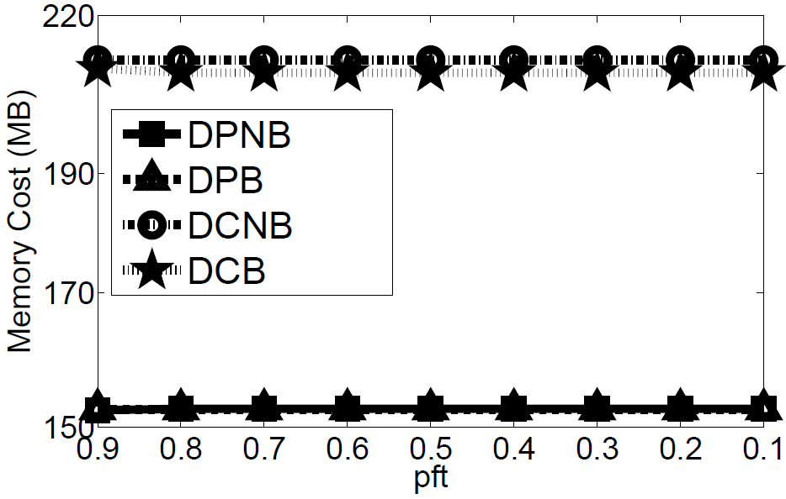
Memory Cost
(a) Accident (Memory w.r.t min_sup) (b) Kosarak (Memory w.r.t pft)

Slide 29
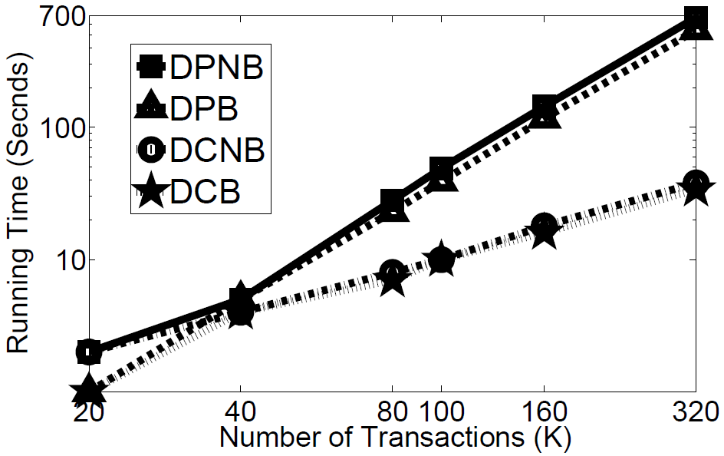
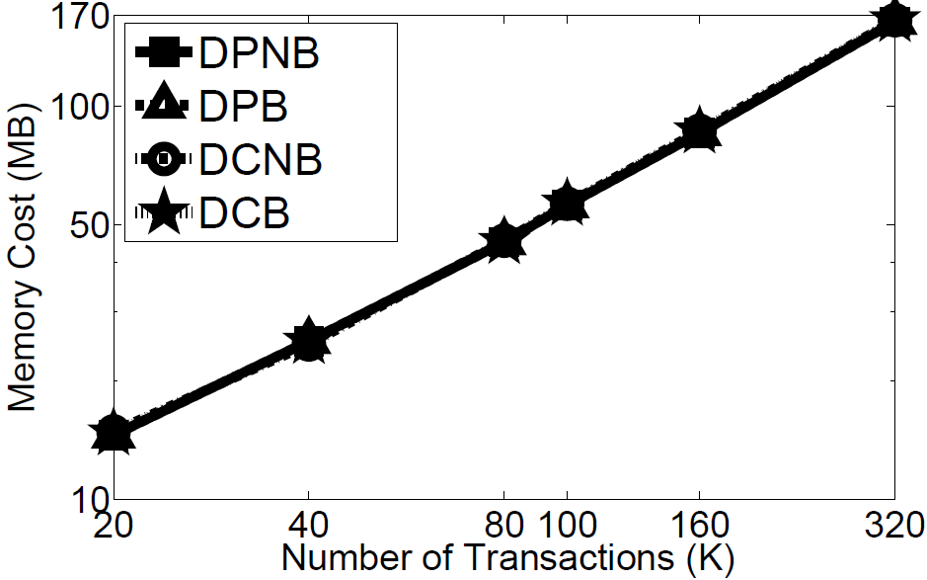
Scalability
(a) Scalability w.r.t Running Time (b) Scalability w.r.t Memory Cost

Slide 30
Review: DC Vs. DP
DC algorithm is usually faster than DP, especially for large data.
  Time Complexity of DC: O(Nlog²N)
  Time Complexity of DP: O(N²)
DC algorithm spends more memory in trade of efficiency
Chernoff-bound-based pruning usually enhances the efficiency significantly.
  Filter out most infrequent itemsets
  Time Complexity of Chernoff Bound: O(N)

Slide 31
Outline
Motivations
  An Example of Mining Uncertain Frequent Itemsets (FIs)
  Deterministic FI Vs. Uncertain FI
  Evaluation Goals
Problem Definitions
Evaluations of Algorithms
  Expected Support-based Frequent Algorithms
  Exact Probabilistic Frequent Algorithms
  Approximate Probabilistic Frequent Algorithms
Conclusions

Slide 32
Approximate Probabilistic Frequent Algorithms
PDUApriori (L. Wang et al., in CIKM’10)
  Poisson Distribution approximate Poisson Binomial Distribution
  Use the algorithm framework of UApriori
NDUApriori (T. Calders et al., in ICDM’10)
  Normal Distribution approximate Poisson Binomial Distribution
  Use the algorithm framework of UApriori
NDUH-Mine (Our Proposed Algorithm)
  Normal Distribution approximate Poisson Binomial Distribution
  Use the algorithm framework of UH-Mine

Slide 33
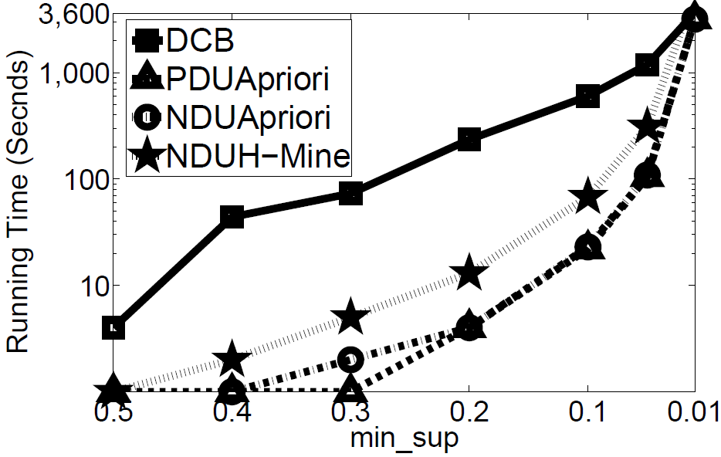
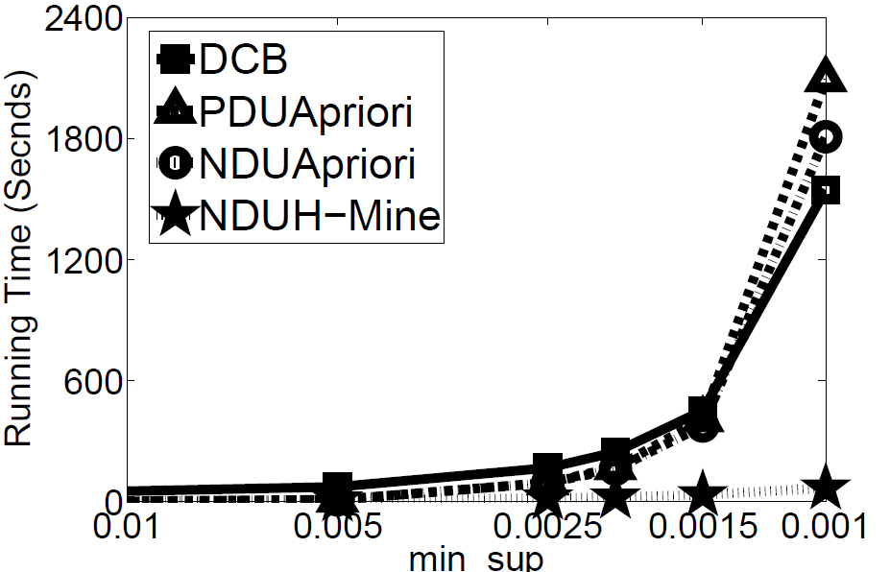
Running Time
(a) Accident (Dense) (b) Kosarak (Sparse)
Running Time w.r.t min_sup

Slide 34
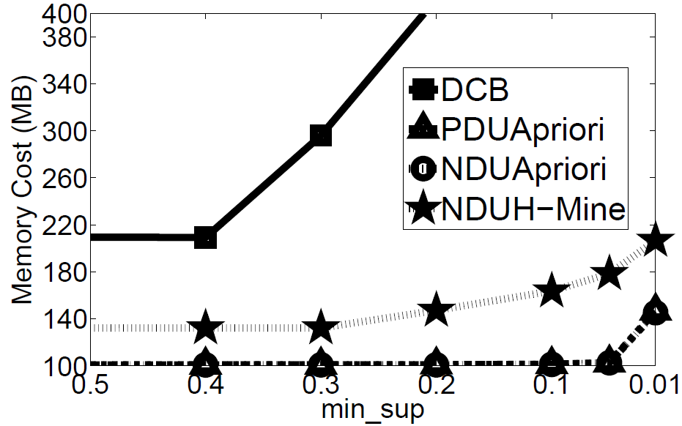
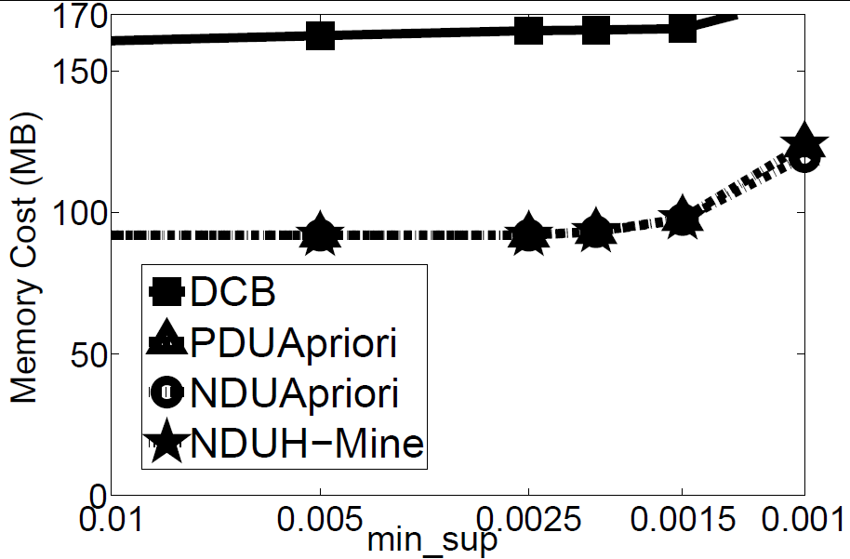
Memory Cost
(a) Accident (Dense) (b) Kosarak (Sparse)
Momory Cost w.r.t min_sup

Slide 35
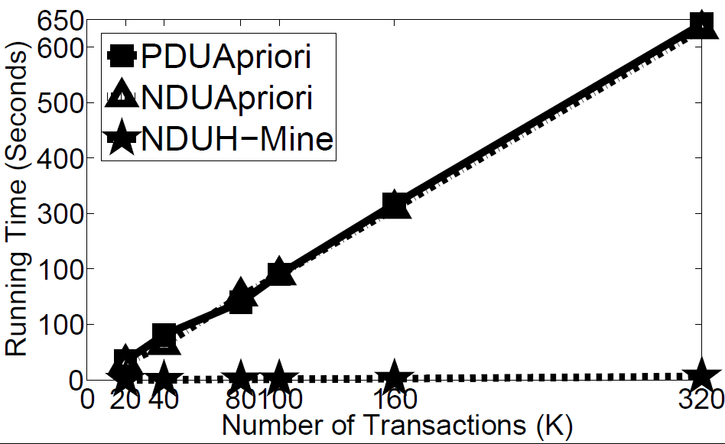
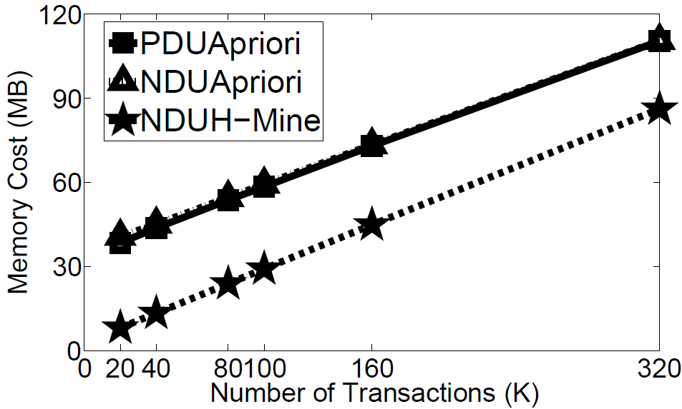
Scalability
(a) Scalability w.r.t Running Time (b) Scalability w.r.t Memory Cost

Slide 36
Approximation Quality
Accuracy in Accident Data Set
min_sup | PDUApriori |  | NDUApriori |  | UDUH-Mine
 | Precision | Recall | Precision | Recall | Precision | Recall
0.2 | 0.91 | 1 | 0.95 | 1 | 0.95 | 1
0.3 | 1 | 1 | 1 | 1 | 1 | 1
0.4 | 1 | 1 | 1 | 1 | 1 | 1
0.5 | 1 | 1 | 1 | 1 | 1 | 1
0.6 | 1 | 1 | 1 | 1 | 1 | 1
Accuracy in Kosarak Data Set
min_sup | PDUApriori |  | NDUApriori |  | UDUH-Mine
 | Precision | Recall | Precision | Recall | Precision | Recall
0.0025 | 0.95 | 1 | 0.95 | 1 | 0.95 | 1
0.005 | 0.96 | 1 | 0.96 | 1 | 0.96 | 1
0.01 | 0.98 | 1 | 0.98 | 1 | 0.98 | 1
0.05 | 1 | 1 | 1 | 1 | 1 | 1
0.1 | 1 | 1 | 1 | 1 | 1 | 1

Slide 37
Review: PDUApriori Vs. NDUApriori Vs. NDUH-Mine
When datasets are large, three algorithms can provide very accurate approximations.
Dense Dataset: PDUApriori and NDUApriori algorithms perform very good
Sparse Dataset: NDUH-Mine algorithm usually performs very good
Normal distribution-based algorithms outperform the Possion distribution-based algorithms
  Normal Distribution: Mean & Variance
  Possion Distribution: Mean

Slide 38
Outline
Motivations
  An Example of Mining Uncertain Frequent Itemsets (FIs)
  Deterministic FI Vs. Uncertain FI
  Evaluation Goals
Problem Definitions
Evaluations of Algorithms
  Expected Support-based Frequent Algorithms
  Exact Probabilistic Frequent Algorithms
  Approximate Probabilistic Frequent Algorithms
Conclusions

Slide 39
Conclusions
Expected Support-based Frequent Itemset Mining Algorithms
  Dense Dataset: UApriori algorithm usually performs very good
  Sparse Dataset: UH-Mine algorithm usually performs very good
  In most cases, UF-growth algorithm cannot outperform other algorithms
Exact Probabilistic Frequent Itemset Mining Algorithms
  Efficiency: DC algorithm is usually faster than DP
  Memory Cost: DC algorithm spends more memory in trade of efficiency
  Chernoff-bound-based pruning usually enhances the efficiency significantly
Approximate Probabilistic Frequent Itemset Mining Algorithms
  Approximation Quality: In datasets with large size, the algorithms generate very accurate approximations.
  Dense Dataset: PDUApriori and NDUApriori algorithms perform very good
  Sparse Dataset: NDUH-Mine algorithm usually performs very good
  Normal distribution-based algorithms outperform the Possion-based algorithms

Slide 40
Thank you
Our executable program, data generator, and all data sets can be found: http://www.cse.ust.hk/~yxtong/vldb.rar

